Slide 1


Healthcare RAG-Powered Medical Question Answering Assistant
Retrieval-Augmented Generation for Evidence-Based Medical Question Answering
Presented by
Abd El-Rahman Mostafa
Youssef George
Doha Khaled
Eman El-Kalawy
Ziad El-Nady
Supervisor
ENG/Abd El-Rahman Tarek
July 2026

Slide 2






Problem Statement
Every Great Project Starts with a Question...
But... Can we trust it?
What are the symptoms of Type 2 Diabetes?
AI gives an answer instantly...

Slide 3
Our Solution
Retrieval-Augmented Generation (RAG)
Retrieve EvidenceRetrieve Evidence
Generate Answer
User Question

Slide 4

How Does It Work?
User Question
BioBERT Classifier
FAISS Retrieval
Predict
Retrieve
Medical Answer
Groq Llama
Generate

Slide 5
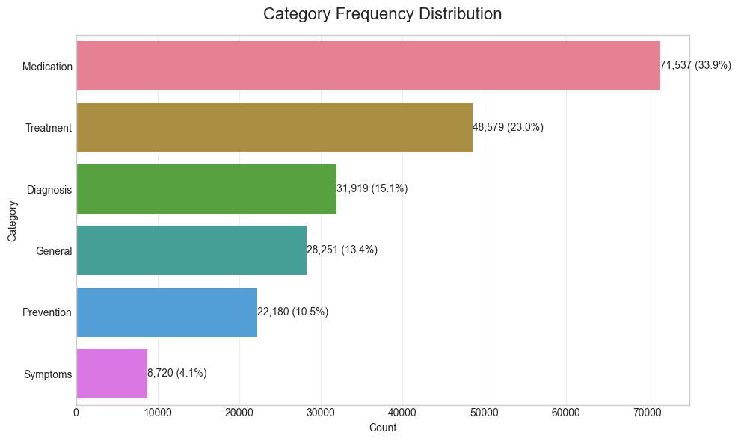
Knowledge Base Construction
Offline Data Pipeline
PubMedQA Dataset
Data Preparation
Category Labelling
Embedding Generation
FAISS Vector Database

Slide 6
What Happens When a User Asks a Question?
Category Selection (Or prediction)
Embedding Generation
User Question
Final Answer
Groq Llama 4
Top-k Medical Chunks
FAISS Search
Online Pipeline

Slide 7
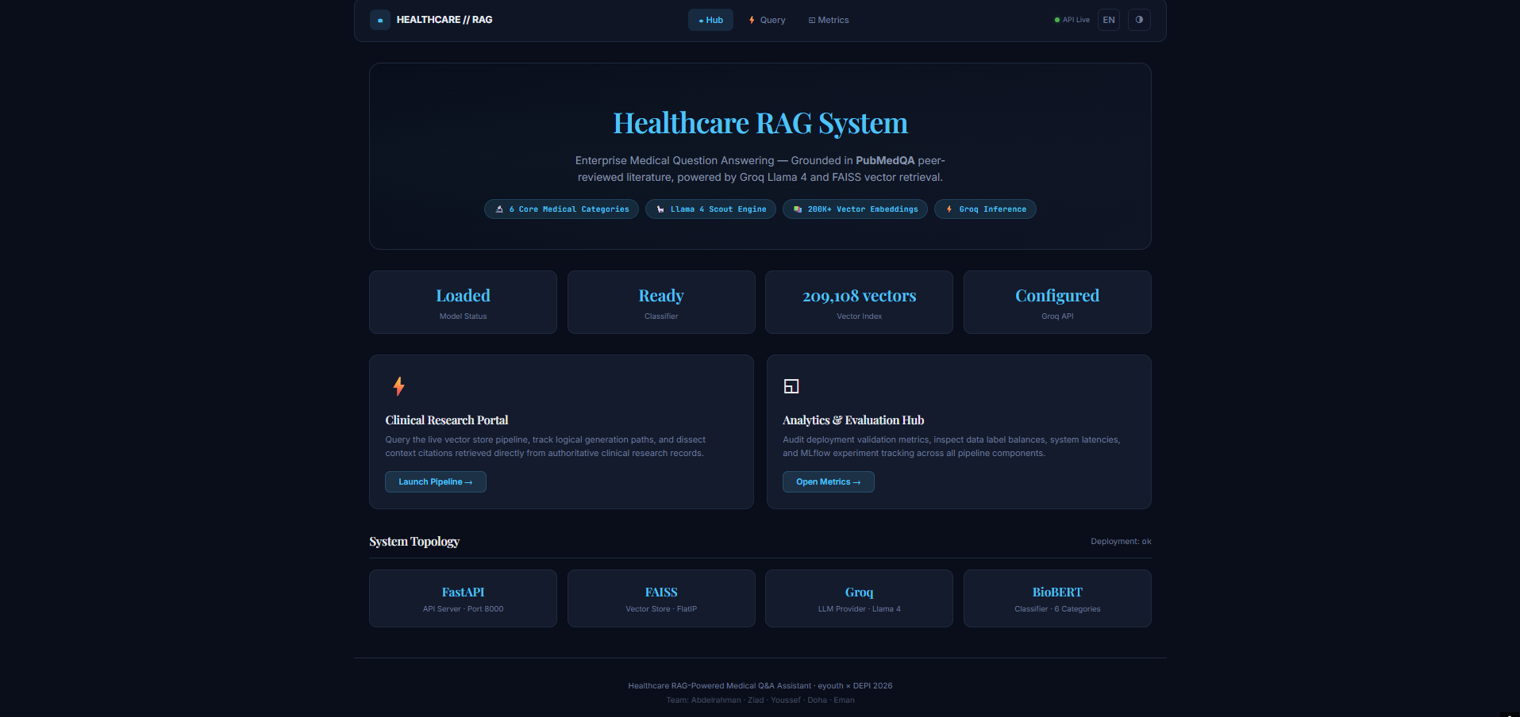
Let's Ask Our Assistant
What are the symptoms of Type 2 Diabetes?

Slide 8
What Did We Achieve?
90.66% Macro F1
91% Accuracy
94.2% Retrieval Precision
86% Faithfulness
10% Hallucination
264 ms Latency

Slide 9

Why Is Our System Better?

Slide 10
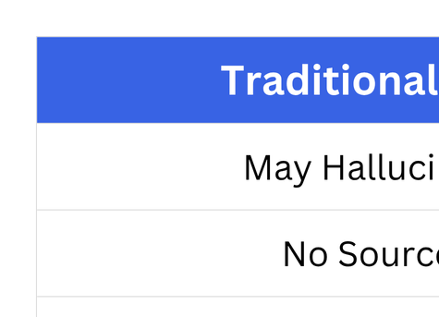

Slide 11
Future Improvements
Automatic Classification
Hybrid Search
Larger Medical Corpus
Multilingual Support
Production Deployment

Slide 12


